Slide 1
El Yunque National Park
By Dora Zheng, Naomi Chavez, and Sabrina Li

Slide 2
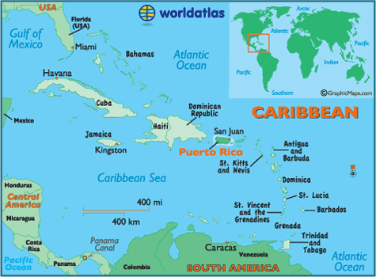
Welcome to El Yunque!
El Yunque is a rainforest located in Puerto Rico.
It was named after the cloud-shrudded mountain tops.
There are so many species of animals that about 80% of them have not been scientifically observed.

Slide 3
Biome Type
El Yunque is a tropical rainforest.
All rainforests are around the equator (0 degrees).
Temperature is high, has only 2 seasons – wet season and dry season.

Slide 4
Abiotic Factors – Rainfall
Average rainfall is 200 in. per year.
It rains year-round
Results in year-round growing season.
Approximately 28,000 acres of diverse vegetation is covered.

Slide 5
Abiotic Factors –Daylight Hours
Hours of daylight each day throughout the year is 11-13.25
Temperature and daylight length remain fairly constant throughout the year.

Slide 6
Daylight Hour Chart
Date | Daylight hours
Jan 21 | 91.482 hours
Feb 21 | 91.935 hours
March 21 | 92.622 hours
April 21 | 93.438 hours
May 21 | 94.100 hours
June 21 | 94.476 hours
July 21 | 94.450 hours
Aug 21 | 94.028 hours
Sept 21 | 93.312 hours
Oct 21 | 92.519 hours
Nov 21 | 91.817 hours
Dec 21 | 91.444 hours

Slide 7
Abiotic Factors- Effect on Ecosystem
Animals and plants are affected by the factors
The wind contributes to the rainfall
Essential for plants
High humidity
Difficult for animals to deal with

Slide 8
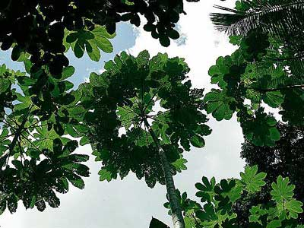
Biotic Factors – Plants
There are:
200 species of birds
22 kinds of mammals
This is a pumpwood tree.

Slide 9
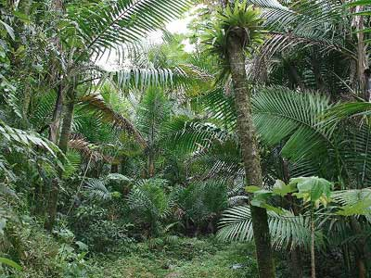
Biotic Factors – Plants
Sierran Palms
Very tall plant with dark green leaves
Plants are significant for the canopy layer.
They make up most of the canopy layer.
This is the Sierran Palms

Slide 10
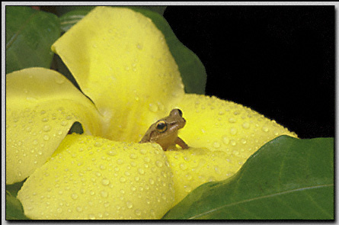
Biotic Factors- Animals
Coqui Frog
Favorite Puerto Rican mascot
It’s unofficial, but is still considered as a symbol of Puerto Rico
Population is decreasing
This is Puerto Rico’s national mascot, the Coqui Frog.

Slide 11
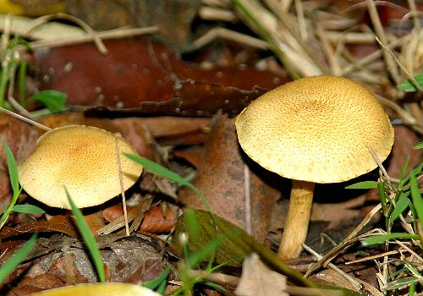
Biotic Factors – 1st Layer Forest Floor
This is covered with “leaf litter” that fall and then decompose.
Animals/insects:
mushrooms
isopods
Decaying organic material:
detritus

Slide 12
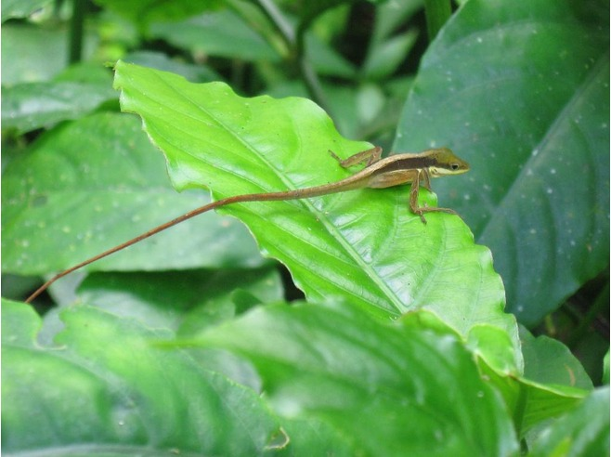
Biotic Factors- 2nd layer Understory
Plants:
Dwarf Trees/plants and vines live with bit of sun and air
Plants rely on insects to pollinate them
Animals/insects:
Ants
Walkingsticks
Giant crabs
Geckos

Slide 13
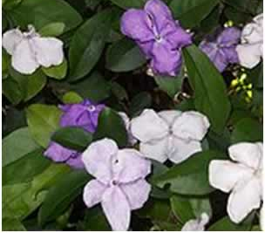
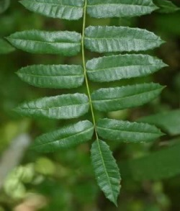
Biotic Factors-3rd layer Canopic
Plants:
Sierran Palms
Plants absorb sunlight
5% goes to the understory layer
When it rains, drops go to understory

Slide 14
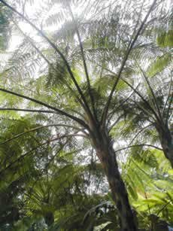
Biotic Factors- 4th layer Emergent
Made up of the tallest trees

Slide 15
Food Chart
Level of Consumer | Organisms
Producer | Sierran Palms, Hibicus, Pumpwood Trees,and Polyporus Mushroom.
First Level | Jamaican Fruit Bat, Lamponius Walkingstick, Wheeleri, Fire Ant, Isopod and Caracolus Snail.
Second Level | Coqui Frog, Tarantulas, Puerto Rico Tanager, Twig Dwarf Anole, Scolopendra Centepide, Fire Ants, Puerto Rican Screech Owl, Red Tailed Hawk, Sphaerodactylus Gecko and Giant Crab Spider.
Third Level | Caracolous Snail, Giant Crab Spider, Puerto Rican Screech Owl, Fire Ant, Blue Tarantula, Red Tailed Hawk, Coqui Frog, Twig Dwarf Anole and Scolopendra Centipede.

Slide 16
Food Chart
Level Of Consumers | Organisms
Fourth Level | Red Tailed Hawk, Coqui Frog, Puerto Rican Screech Owl, Giant Crab Spider, Puerto Rican Tanager and Twig Dwarf Anole.
Fifth Level | Giant Crab Spider, Scolopendra Centepide, Puerto Rican Screech Owl and Red Tailed Hawk.
Sixth Level | Red Tailed Hawk, Puerto Rican Screech Owl, Sphaerodactylus Gecko, Coqui Frog and Fire Ant
Seventh Level | Red Tailed Hawk
Decomposer | Bacteria

Slide 17
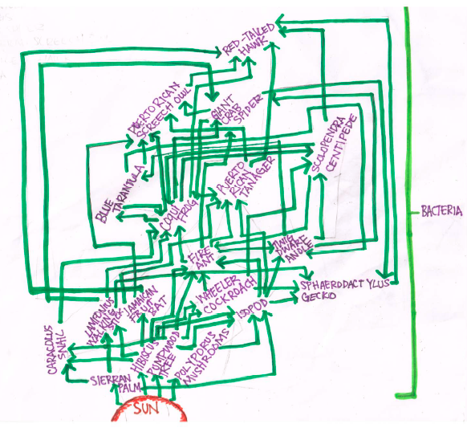
Food Web

Slide 18
Issues
Habitat loss
Covers only 6% of Earth’s surface
9,000 acres cleared every hour
Main organisms are hurt
Coqui Frogs rapidly dercreased since the 1500’s

Slide 19
Work Cited Page
www.fossweb/nyc.com
www.google.com to find pictures
www.elyunque.com

